Slide 1


GRID Map
(Global Real-time Interactive Disaster Map)

Slide 2




Motivation
Notes:
Add other stock pictures of natural disasters

Slide 3
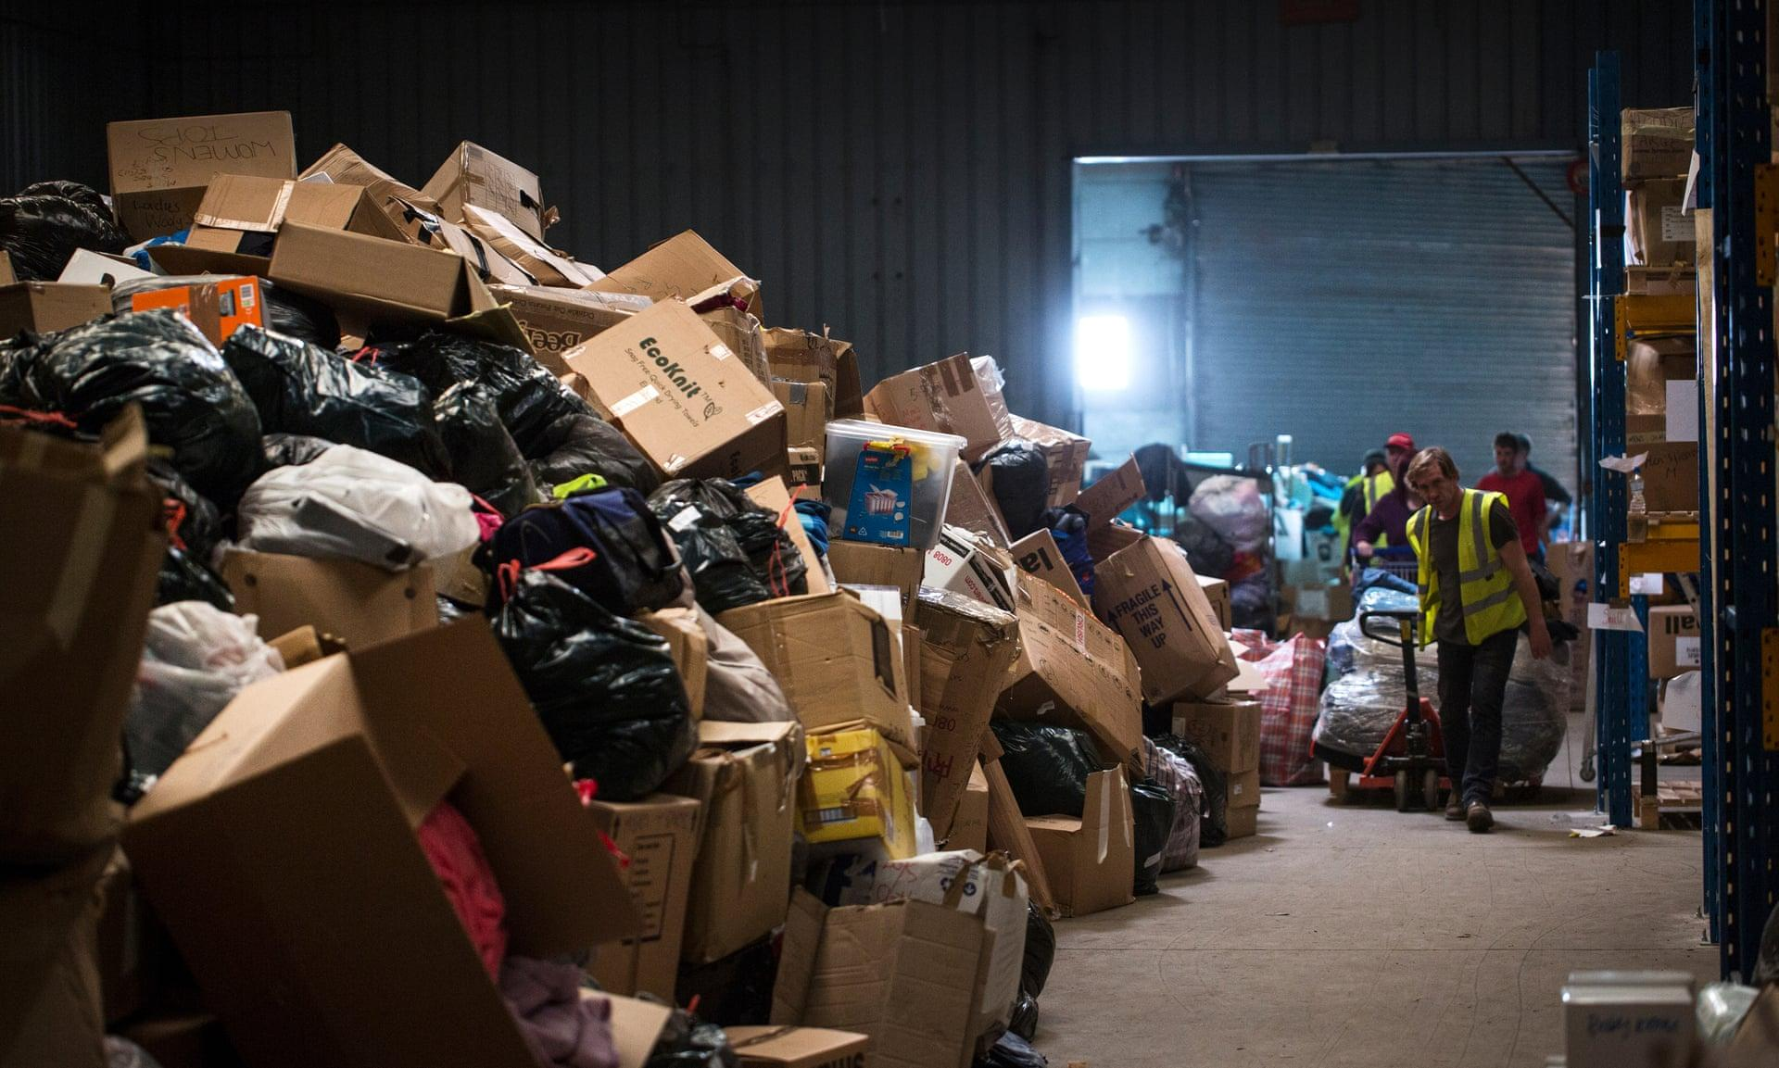

Slide 4



Around the world...
South East Asia Tsunami (2004):
72% of NGOs did not share analytics
Lack of transparency
Indonesia Flood (2005)
20 independent relief posts clustered
Resources wasted
Hurricane Katrina (2005)
Only 27/66 ambulances were provided
Lack of accountability
Notes:
List global case studies like Indonesia and Puerto Rica’s wasted resource stories: https://www.pogo.org/analysis/2017/09/disaster-relief-needs-oversight-to-stop-waste-and-fraud/, https://townhall.com/tipsheet/mattvespa/2017/10/19/wasted-puerto-rican-hurricane-relief-aid-found-tossed-in-a-garbage-dump-n2397009
Post-disaster analysis from MIT source: 7.2.2 talks about most organizations not leveraging information from others
Explain how UN wants this too: https://www.un.org/press/en/2018/ga12106.doc.htm
Supply chain management for Disaster Relief Operations: Principles and case
Studies: Case Study 2: 20 posts for relief centres in Indonesia weren’t coordinating via Satlak, the local authority for relief operations

Slide 5
Supply Chain Management
Production
Supply
Inventory
Information
Transportation
Location
Notes:
Diagram of supply chain management (include UNHRD as examples), identify problem in information stage where different organizations fail to coordinate well with each other and there’s lack of visibility; also lack of accountability since there’s no feedback

Slide 6


NGO A
NGO B
NGO C
Oversaturated Resource
Neglected Resource
NGO D

Slide 7
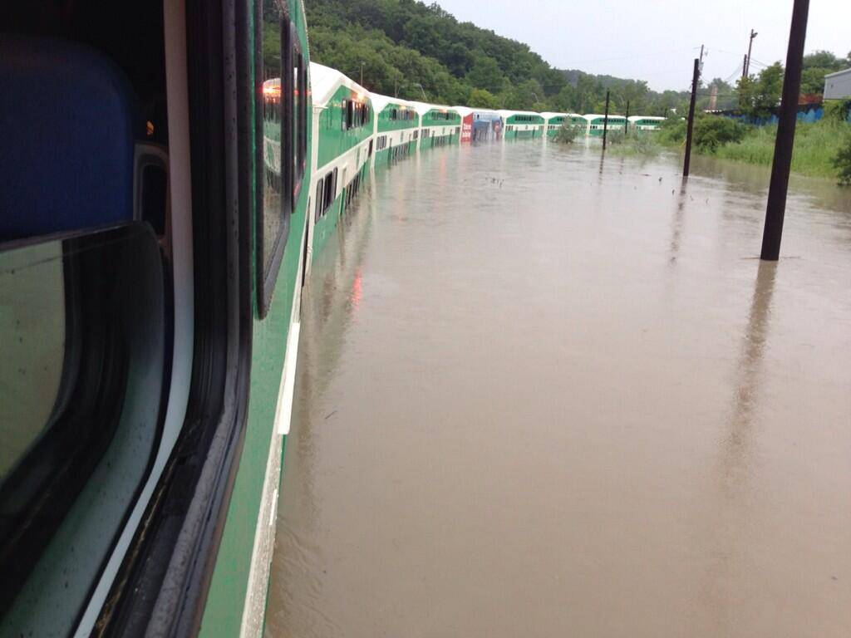



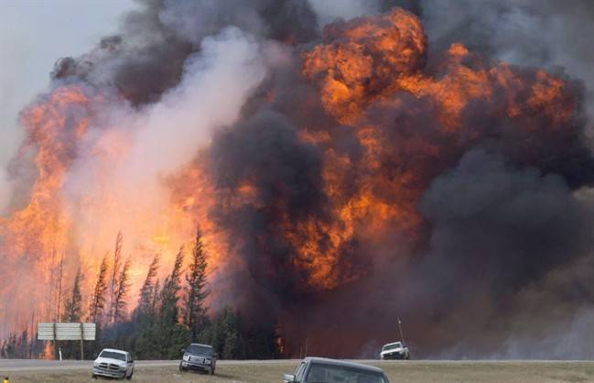


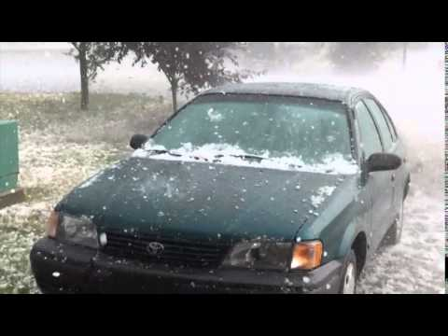

$943m lost
$3.58b lost
$538m lost
Notes:
Show Canadian NGO stakeholders
Show quick stats of number of disasters per decade
Illustrate the need for an organization for coordination

Slide 8
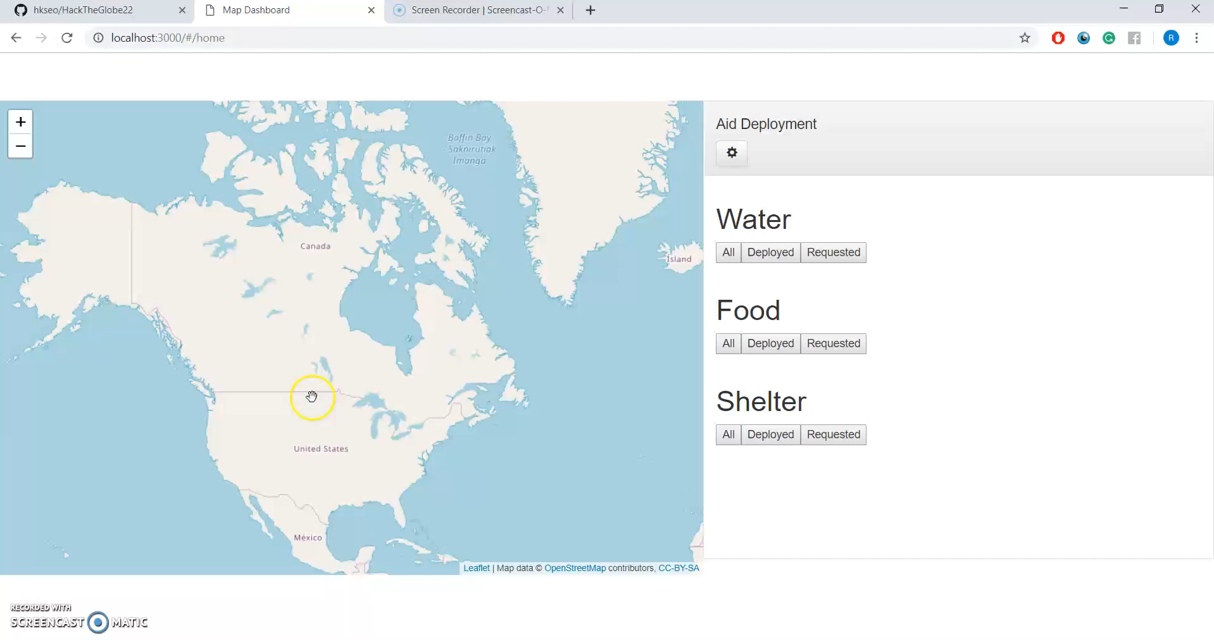

Slide 9
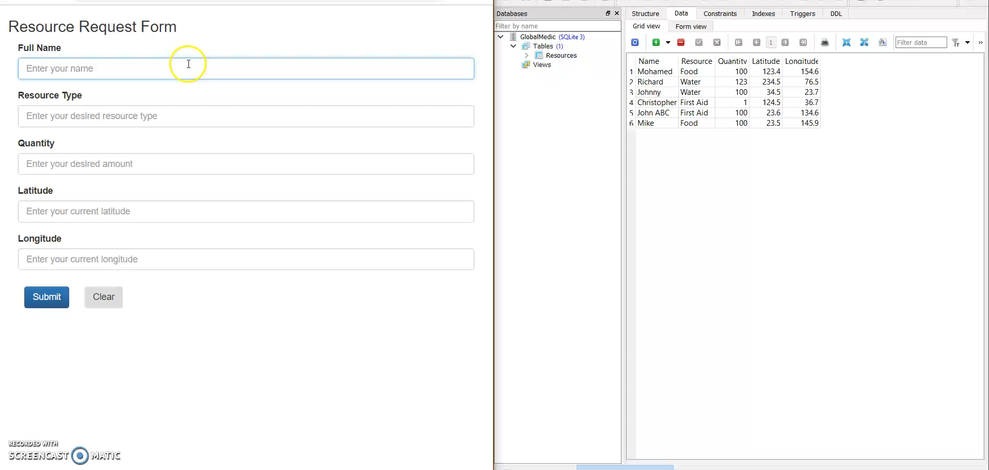

Slide 10
Login
Organizational access (write & read) Governmental access (write & read)
Individual access (read)
Disaster
Choose the current disasters to support:
Long term
Short term
MAP
Comprehensive view of resource distribution and requests

Slide 11
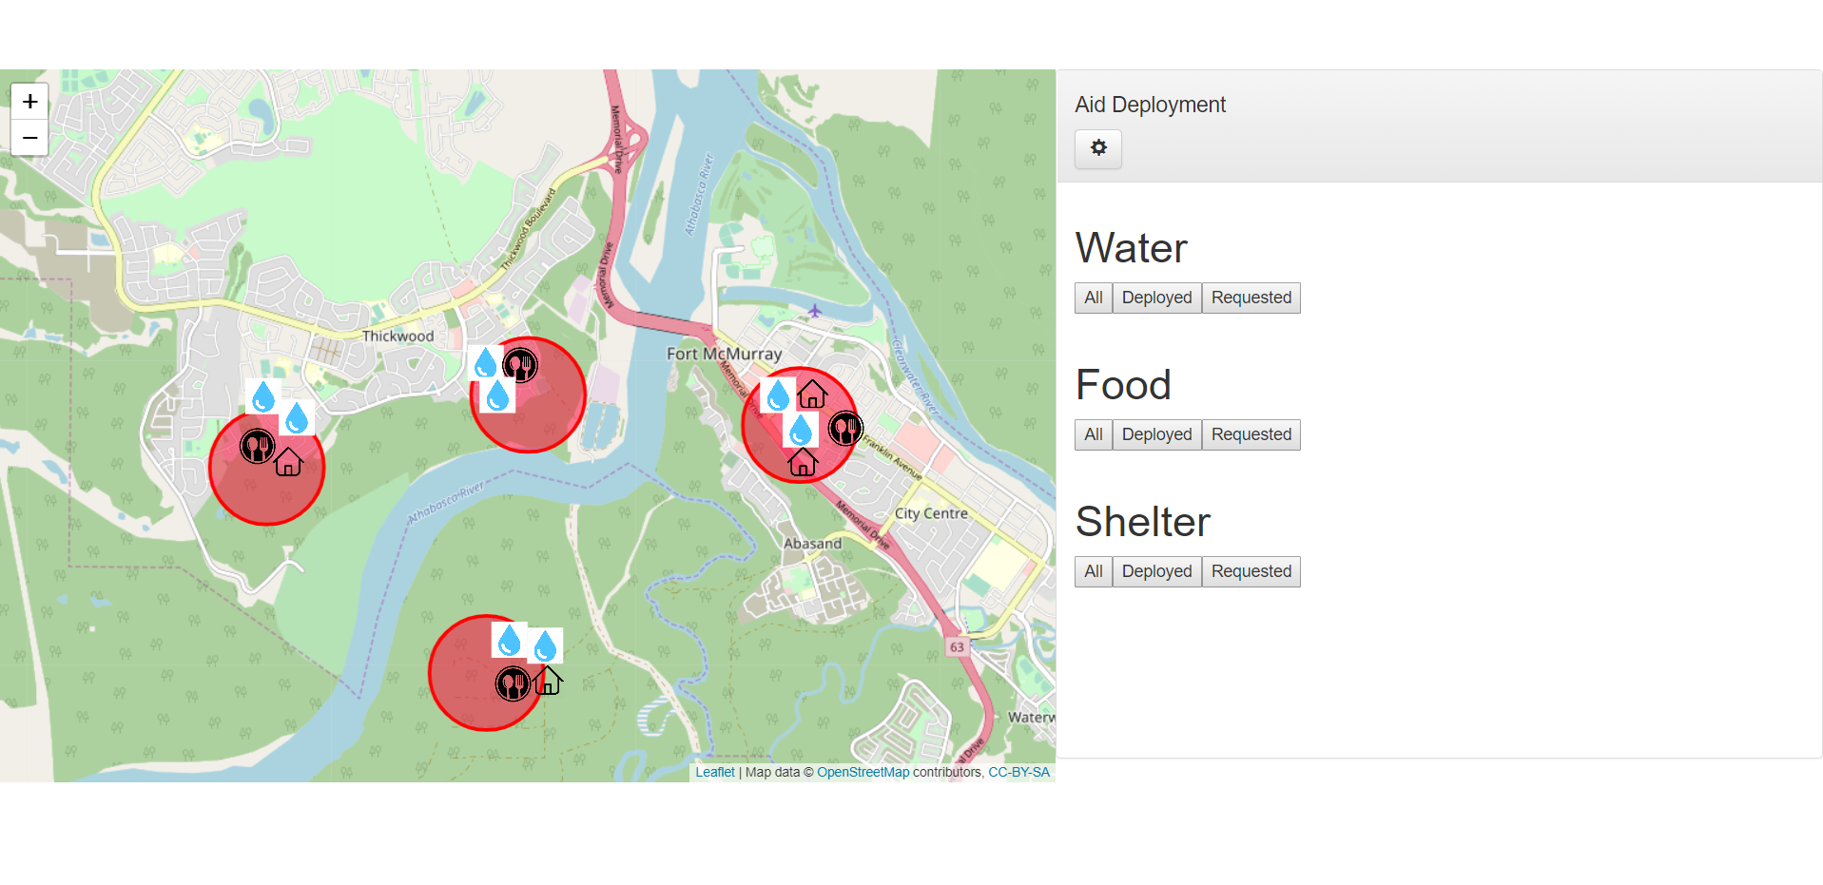


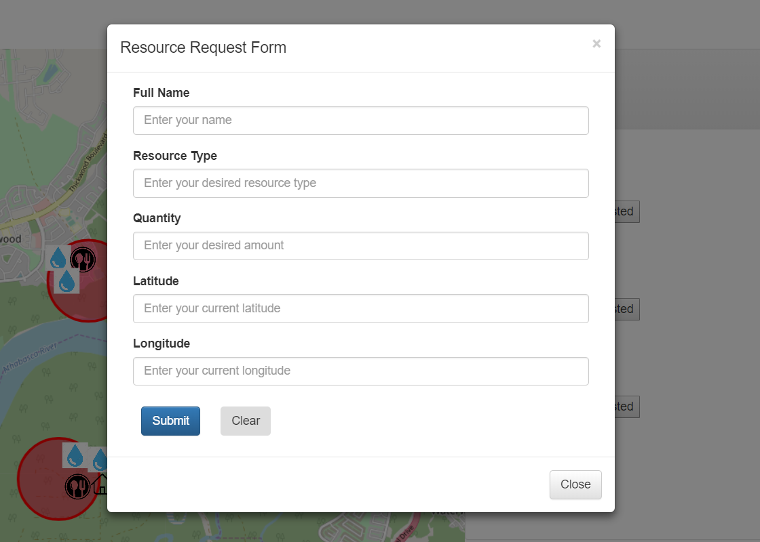


GRID Map
Comprehensive resource distribution details
Clear indicators of areas in need
Visibility provides mutual and public monitoring
Data on performance as a whole
Notes:
Click on map to say where the user is; form pops up to the side which lets you update database (water, shelter, food), and then user can update the database saying which resource is requested, in transit, or arrived

Slide 12





Indonesia Flood (1988)
Coordination
Savings
1%
$490 mil
$4.9 mil
Estimated spending on foreign relief posts
Duplicated efforts or oversourced
Used inefficiently
Notes:
Our product offers coordinations among organtions white leads to savings

Slide 13

Hurricane Katrina (2005)
Billed
Delivered
Visibility
$3100 each / day
$120,900 / day
Accountability
Notes:
As mentioned before, during Hurricane Katrina, the failure to deliver results in loss of life saving opportunities and resources what could be but in better use.
Public visibility to an organization’s plans and commitment imposes accountability.

Slide 14

Data
The Economist Intelligence Unit
46%
Efficiency
Public, Private, and NGO sectors hoped for more data analytics and transparency during times of crisis
Notes:
Our product offers coordinations among organtions white leads to savings

Slide 15
Getting NGOs involved
Donors
Individuals, government, corporations
NGOs
Provide information to GRID Map
Benefit Cycle
Media
News, websites, social media
GRID Map
Media partnership program

Slide 16




Core values to solve the problem
Enable
Accountability
Build Trust
Efficiency
Reliability

Slide 17
Thank you

Slide 18
Appendix

Slide 19


Reference Maps
 | DirectRelief | ReliefWeb | GRID Map
Transparency?
Real-Time?
Coordination?
Notes:
Show DirectRelief Aid Map, ReliefWeb, and our solution in comparison table showing key features (and maybe core values as well)

Slide 20
Development Plan
Jan, 2021:
200 NGOs
June, 2022: 1000 NGOs
Oct, 2019: sw roll out in Canada
Oct, 2020: Media Partnership Program
June, 2020: first 50 NGOs & Gvn’t
Dec, 2023: Adv. analysis
Oct, 2021: Int’l roll out
Now

Slide 21
Future Functionalities
Predict severity of disasters based on user input
Predict severity of disasters using machine learning
Predict optimize amount of resources to allocate based on severity estimate

